Slide 1
Lecture 2 Finite Automata
Deterministic finite automata,
nondeterministic finite automata
their equivalence and
minimization

Slide 2


Classical Theory
Algorithm
Decidability
Efficiency (P vs. NP)
decidable
inefficient
efficient

Slide 3
Structural Induction
Definition: An expression is defined inductively as follows:
Any number or letter is an expression
If E and F are expressions, so are E+F. E*F and (E).
Theorem: Every expression has an equal number of left and right parentheses.

Slide 4
Example: Automatic door
door
Front Pad
Rear Pad
How do you automatize ATM?

Slide 5
State Diagram
Automatic Door as an automaton
Front
Rear
Both
Rear
Both
Neither
Front
closed
closed
closed
closed
closed
Open
closed
closed
Neither
Neither Front Rear Both
Closed
open
Closed Open Closed Closed
Open Closed Open Open

Slide 6
Example: A Simple Automata
0
1
1
0,1
Previous
string OK,
does not
end in 1.
Previous
String OK,
ends in a
single 1.
Consecutive
1’s have
been seen.
A
0
B
C
Accepts all strings without two consecutive 1’s.
Start
A

Slide 7
A Mathematical “Cousin”
1/4
Markov Chain:
How to define a probabilistic automaton
A
1/8
5/8
 | A | B | C
A | 1/4 | 1/8 | 5/8
B | 1/4 | 3/8 | 3/8
C | 1/2 | 1/2 | 0
1/4
1/2
B
C
0
3/8
1/2
3/8

Slide 8
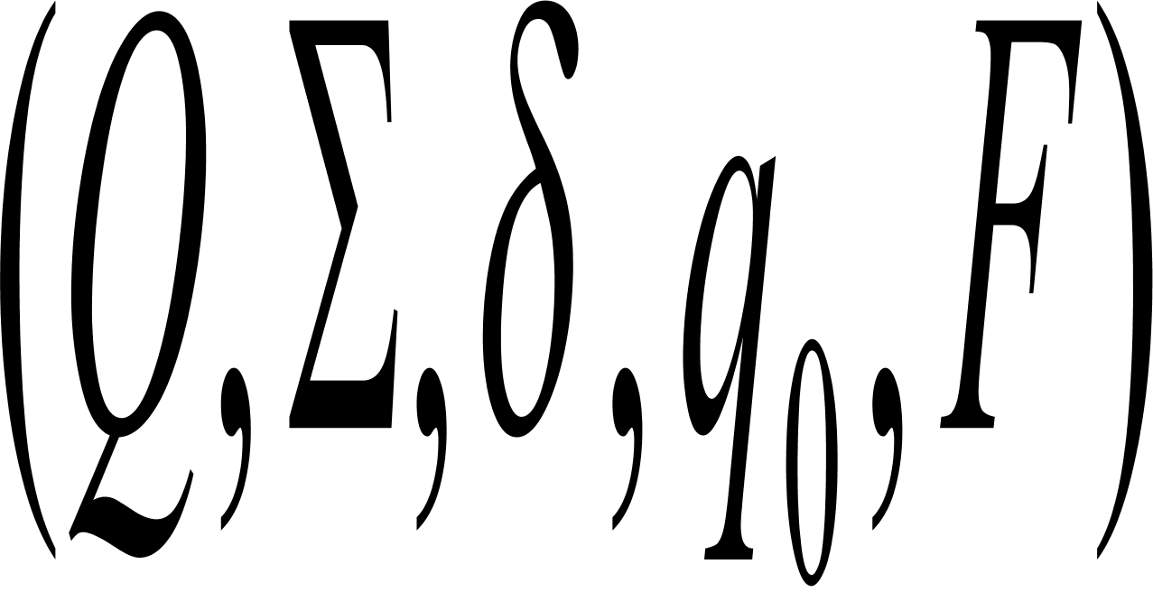

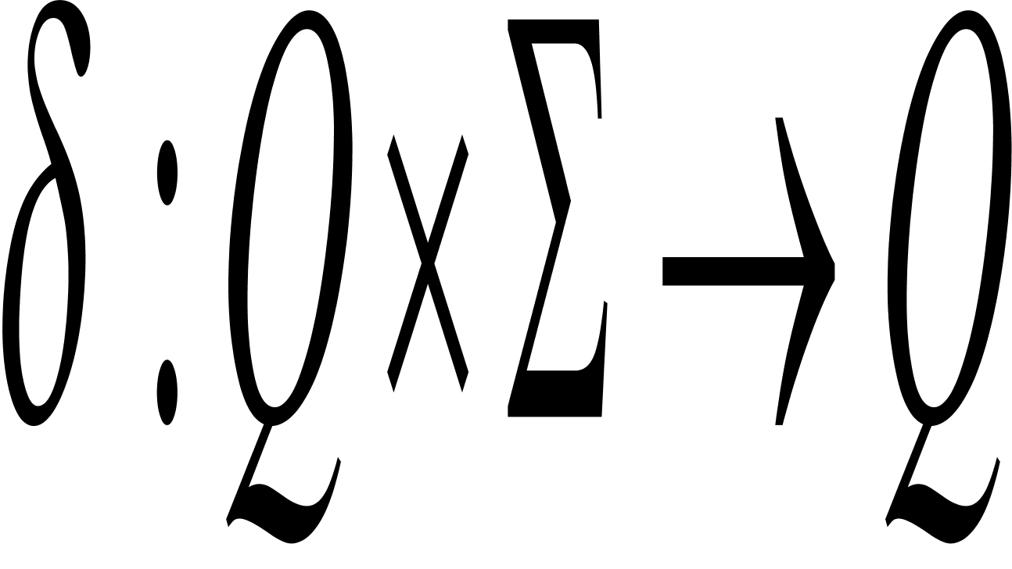

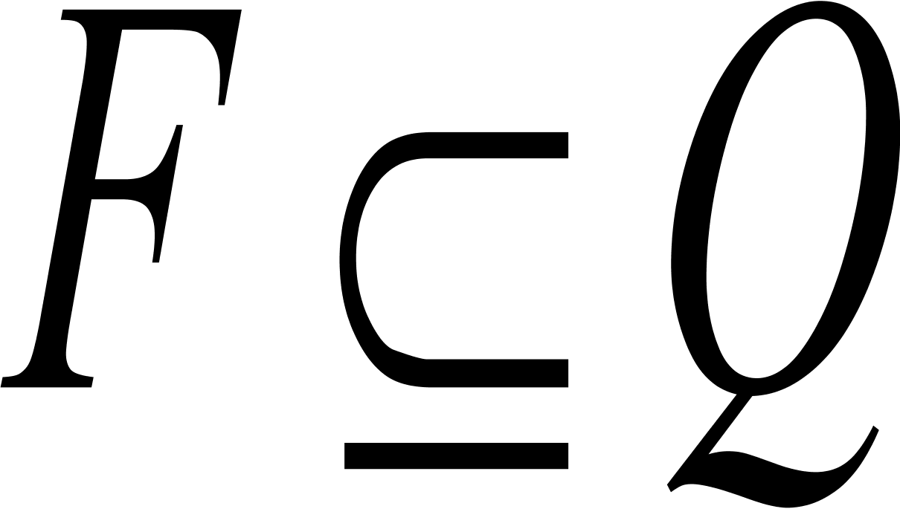
Formal Definition
A deterministic finite automaton (DFA) is a 5 tuple
Q is a finite set called the states;
is a finite set called the alphabet;
is the transition function;
is the start state, and
is the set of accepting states.

Slide 9

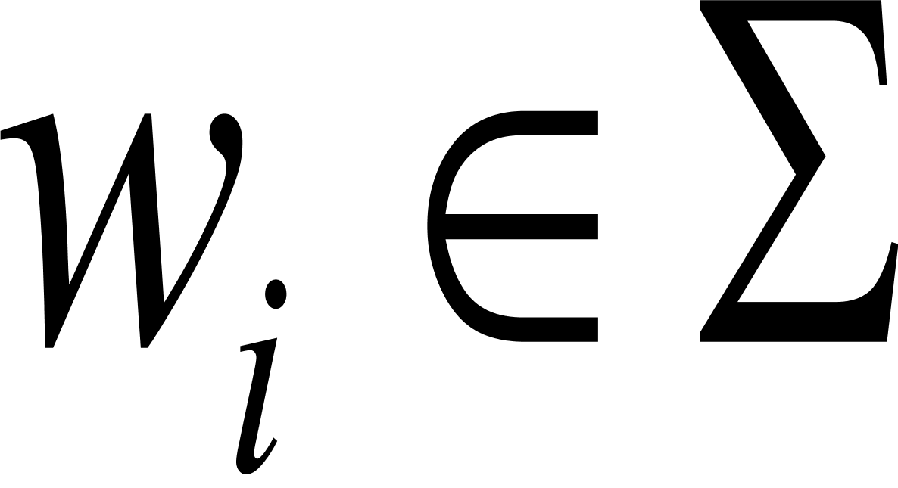
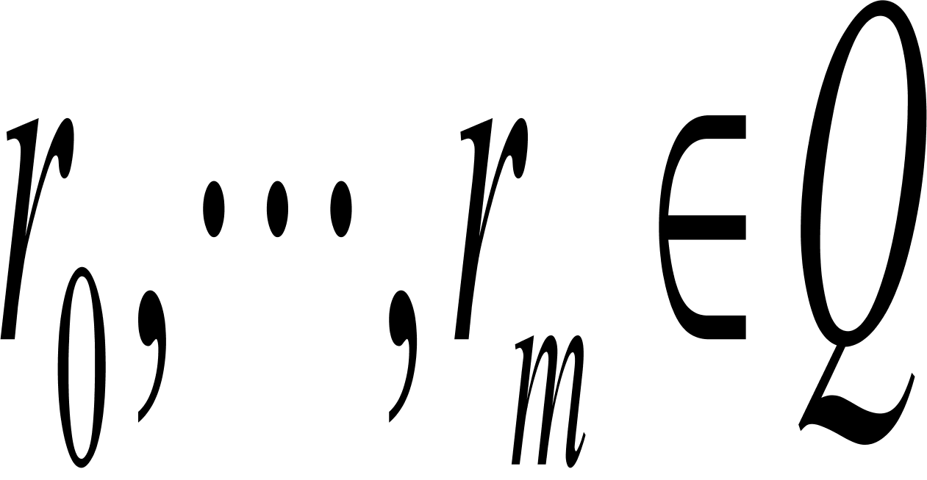
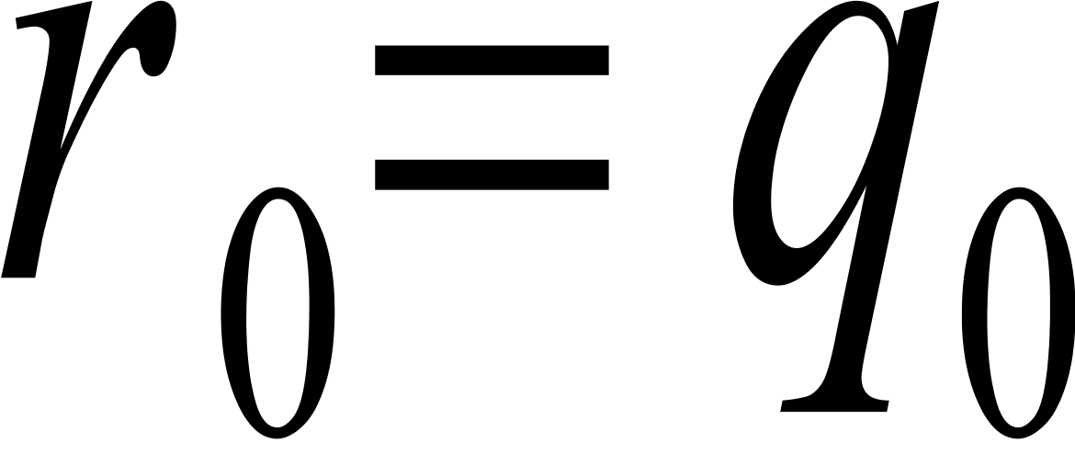
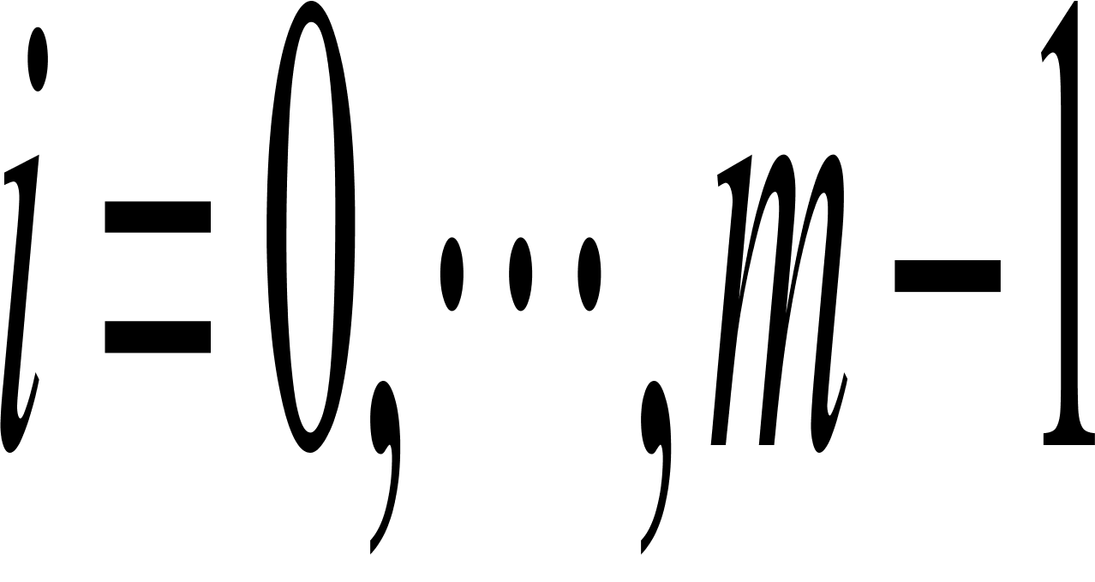
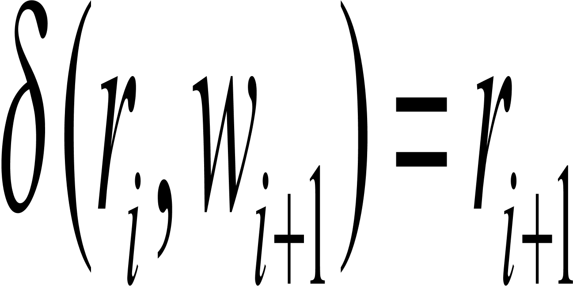
Formal Definition of Computation
A DFA M accepts input w if w can be written as where and sequences of states exist that satisfy the following conditions:
For , we have
rm is an accept state.
Computations,Derivations and Proofs

Slide 10
Languages recognized by FA
If A is the set of all strings that machine M accepts, then A is called the language of M and write L(M)=A. We say that M recognizes A or M accepts A.
Two machines are equivalent if they recognize the same languages.
If machine M accepts no strings, then L(M) is the empty language.

Slide 11
Example: a 5-state automaton
S
a
b
a
r1
b
q1
r1
q1
a
b
b
a
q2
r2
b
a

Slide 12
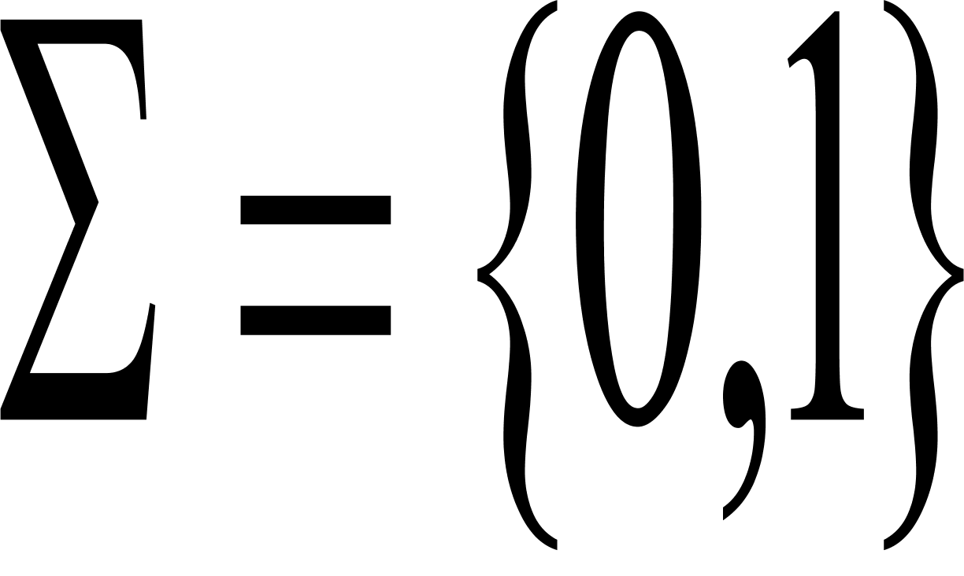
Design Automata
Suppose Construct a finite automaton M recognizing the following languages:
A is the set of all strings with an odd number of 1’s.
A is the set of all strings 001 as a substring
A is the set of all strings except 11 and 111
The set of all strings except the empty string
How do you know which one among equivalent automata is the minimal or the optimal?
Is there an algorithm for designing automata?

Slide 13

A glimpse of nondeterminism
0,1
0,1
q1
1
0,
1
q1
q1
q1
q2
q3
q3
q4
q4
Consider the computation of this FA on input 010110

Slide 14
Computation tree of nondeterministic FA
2
1
2
3
1
2
3
1
……..
reject
……..
………
accpet
reject

Slide 15
Designing NFAs
Design a NFA that recognizes the language consisting of all strings over {0, 1} containing a 1 in the third position from the end.
Design an equivalent DFA and compare these two automata.

Slide 16
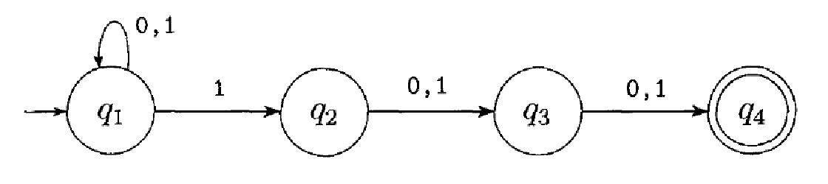
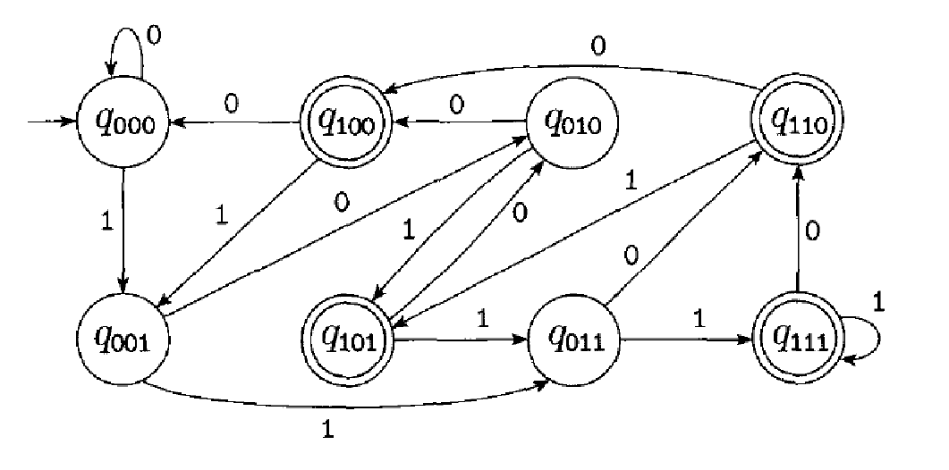
Comparison

Slide 17
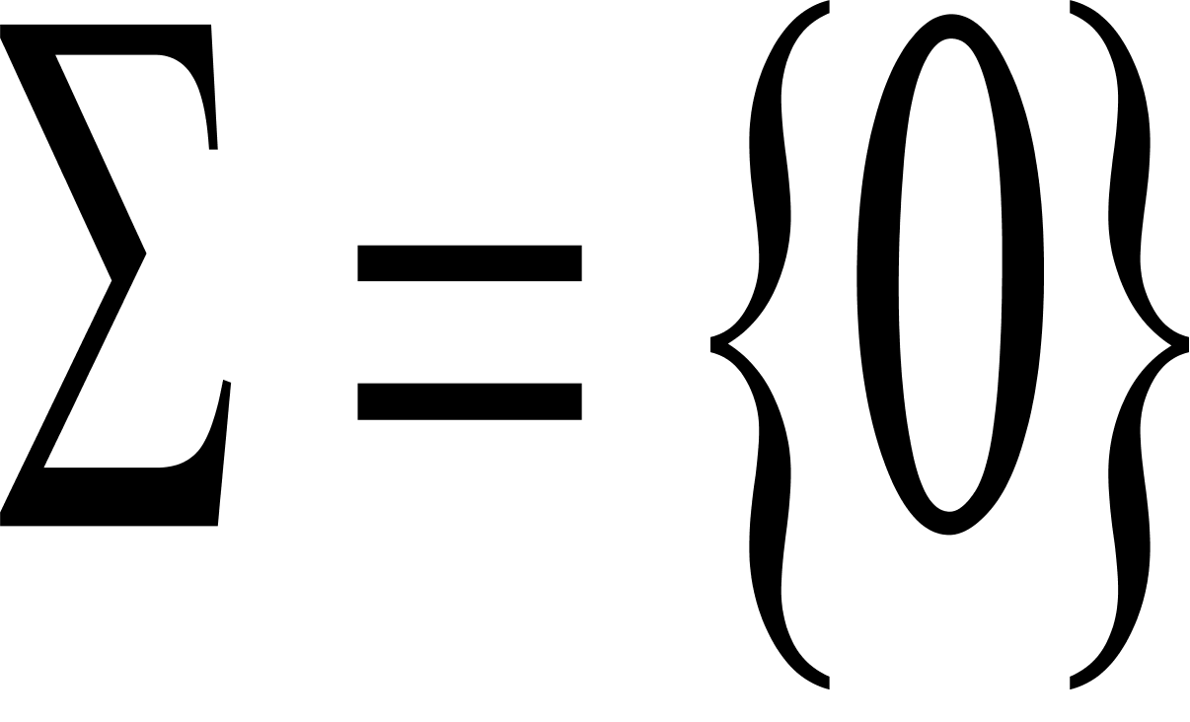
Epsilon-transition
Assume that
0
0
0
0
0

Slide 18
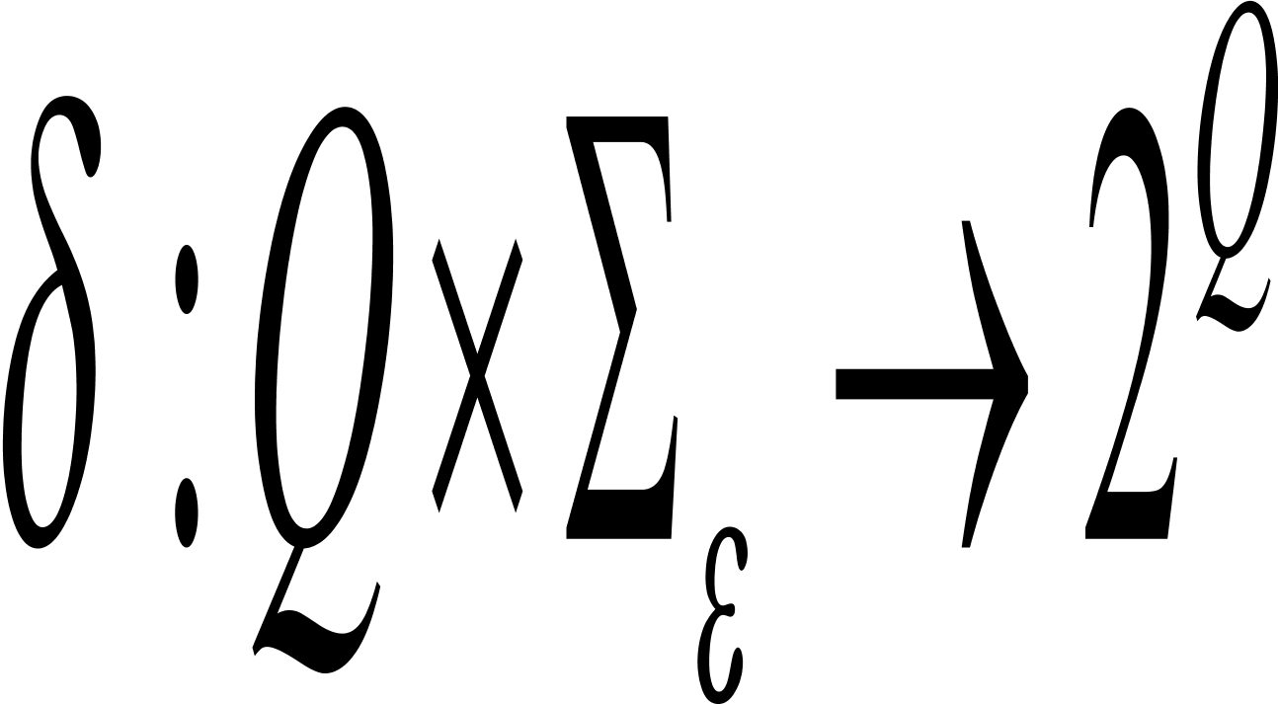
Nondeterministic Finite Automaton
A nondeterministic finite automaton is a 5 tuple
Q is a finite set called the states;
is a finite set called the alphabet;
is the transition function;
is the start state, and
is the set of accept states.
Two extensions: nondeterminism + the empty-string

Slide 19
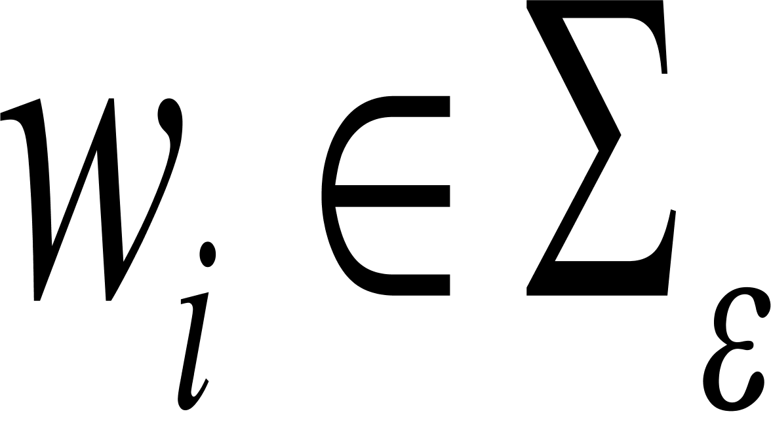
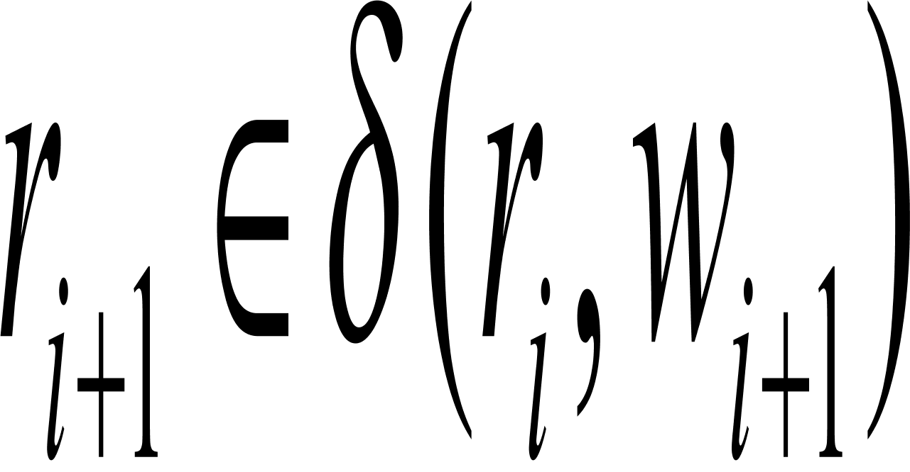
Formal Definition of Computation
A NFA M accepts input w if w can be written as where and sequences of states exist that satisfy the following conditions:
For , we have
rm is an accept state.

Slide 20
Equivalence of NFAs and DFAs
Every nondeterministic finite automaton has an equivalent deterministic finite automaton.
Proof: Subset construction by Scott and Rabin(1959).

Slide 21
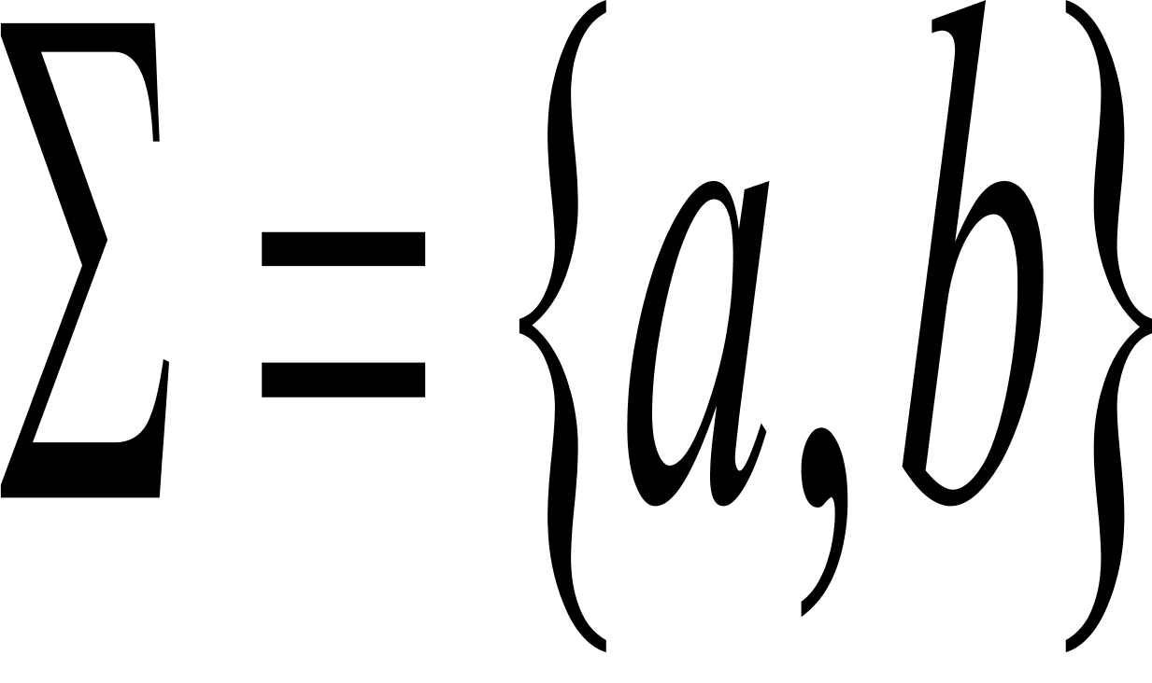
Converting NFAs to DFAs
Assume that
1
1
a
b
2
3
a
a,b
What is the expressive power of the NFA without epsilon transition?

Slide 22
Summary
DFA’s, NFA’s both accept exactly the same set of languages: the regular languages (next time).
The NFA types are easier to design and may have exponentially fewer states than a DFA. Nondeterminism is a synonyms for guess or search.
But only a DFA can be implemented!

Slide 23
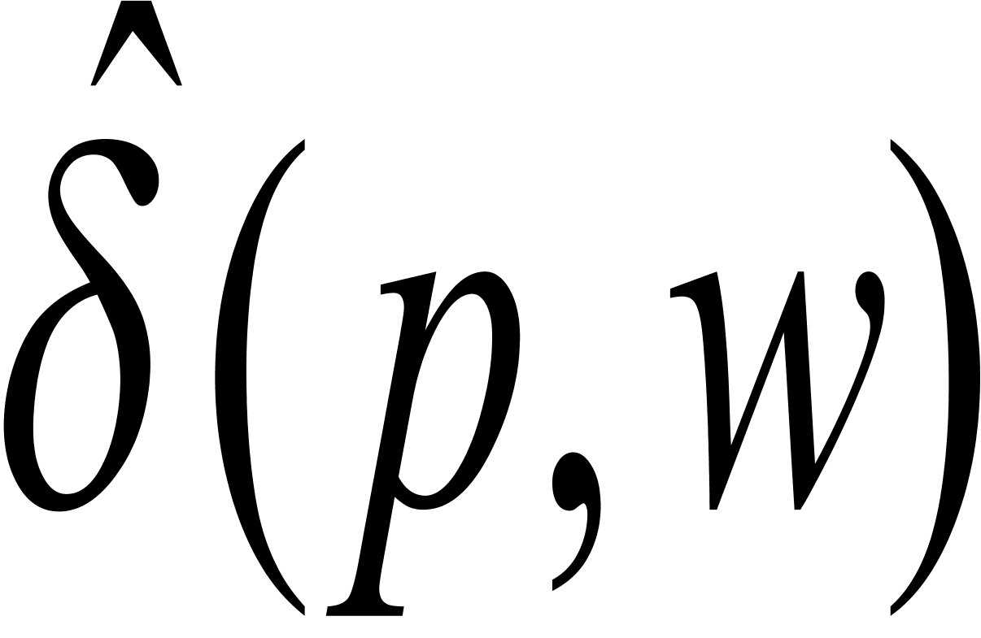
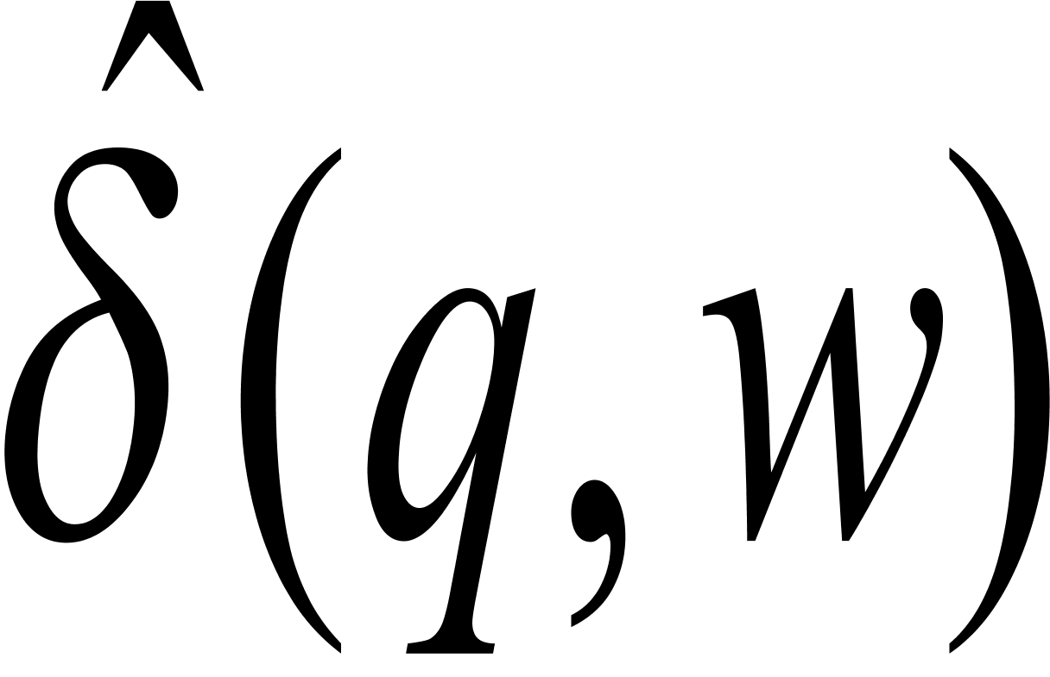
Equivalence
Given a DFA, two states p and q are equivalent if
For all input strings w, is an accepting state iff is an accepting state.
w
p
…..
q
w

Slide 24
Example
1
0
A
B
1
C
0
D
0
c
1
0
1
0
1
E
F
G
0
H
1
1
0
1
0

Slide 25
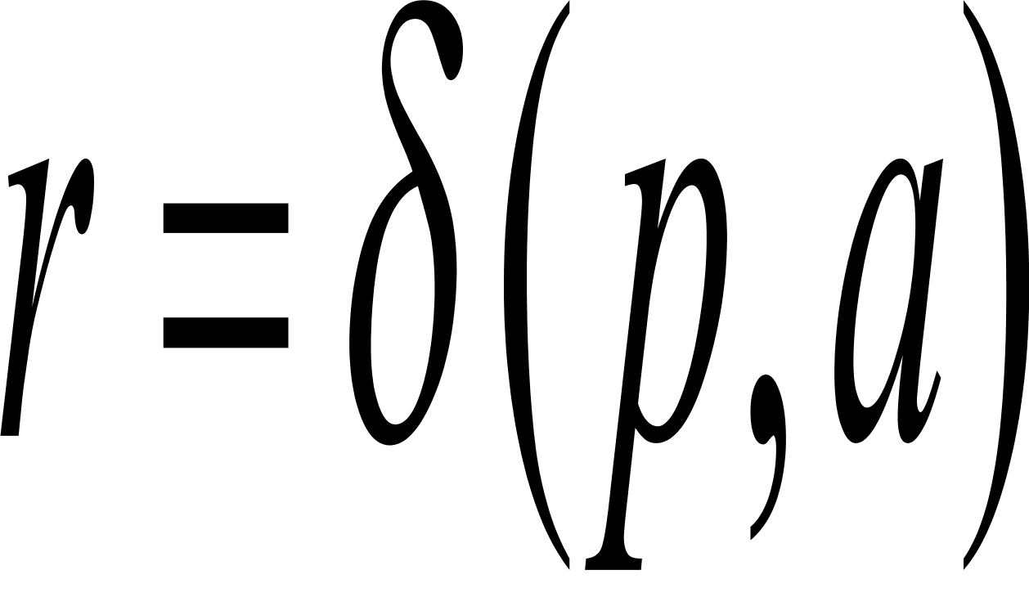
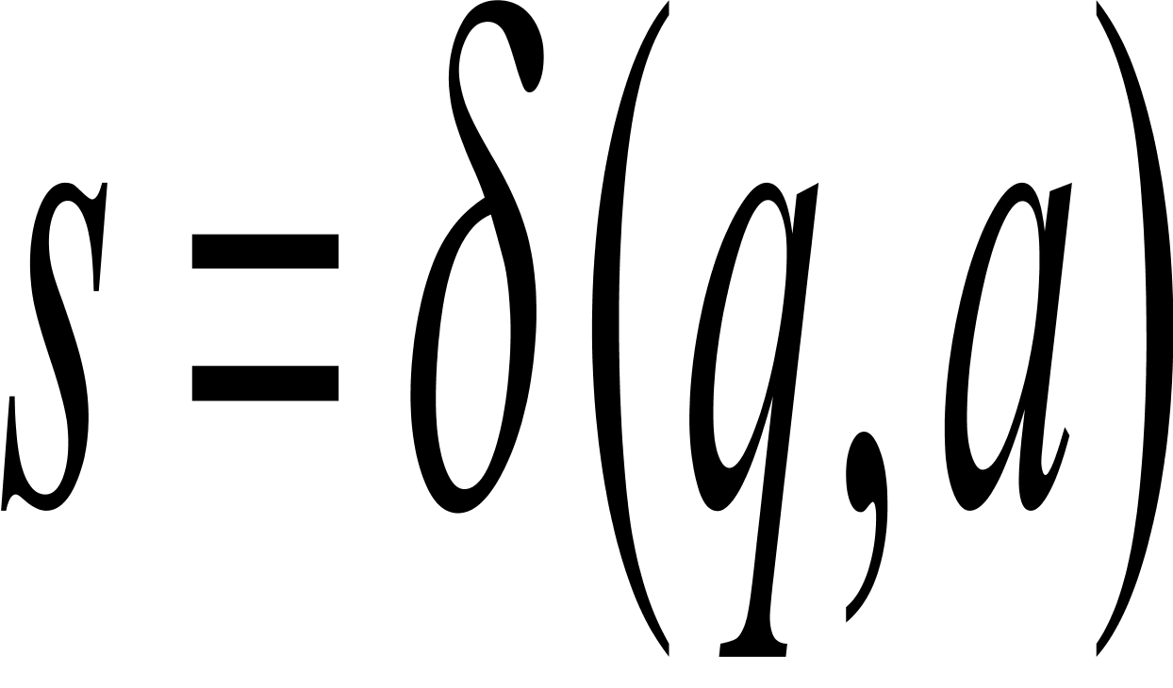
Distinguishable states
Base case: If p is an accepting state and q is a nonaccepting, then the pair {p,q} is distinguishable;
Induction case: Let p and q be states such that for some input symbol a, and are a pair of distinguishable states. Then {p, q} is a pair of distinguishable states.
Are accepting states indistinguishable?

Slide 26
Table-filling algorithm (Where should we start?)
 | A | B | C | D | E | F | G | H
A
B | x
C | x | x
D | x | x | x
E |  | x | x | x
F | x | x | x |  | x
G | x | x | x | x | x | x
H | x |  | x | x | x | x | x
Why does this algorithm give the minimal automata?

Slide 27
Testing equivalence of DFAs
Recall that
two DFAs are equivalent if they accept the same language.
Testing equivalence of DFAs can be transformed into testing equivalence of their starting states.

Slide 28
Example: Two equivalent DFAs
0
1
start
A
1
B
0
start
C
0
D
0
0
1
1
It suffices to show that the starting
states are indistinguishable.
E
1

